Slide 1

Stage 1 Check Your Corners Course Designer: Marcel Englmaier
Check Your Corners is a 45 round, 225 point Comstock course. There are 10 USPSA targets, 10 IPSC targets, 4 steel targets, and a single Clay. The best two hits per target will score. Steel must fall to score. Clay must be shot to score but is a bonus target. The start signal is audible.
The start position is standing with toes touching marks and wrists below belt. Both firearms are UNLOADED and staged in dump box.
On the audible start signal, engage targets from within the shooting area. USPSA targets may be engaged with PCC ONLY. IPSC targets may be engaged with Handgun ONLY. Steel may be engaged with either Handgun or PCC, NO RIFLE. Rifle is permitted to swap for PCC in this bay.

Slide 2
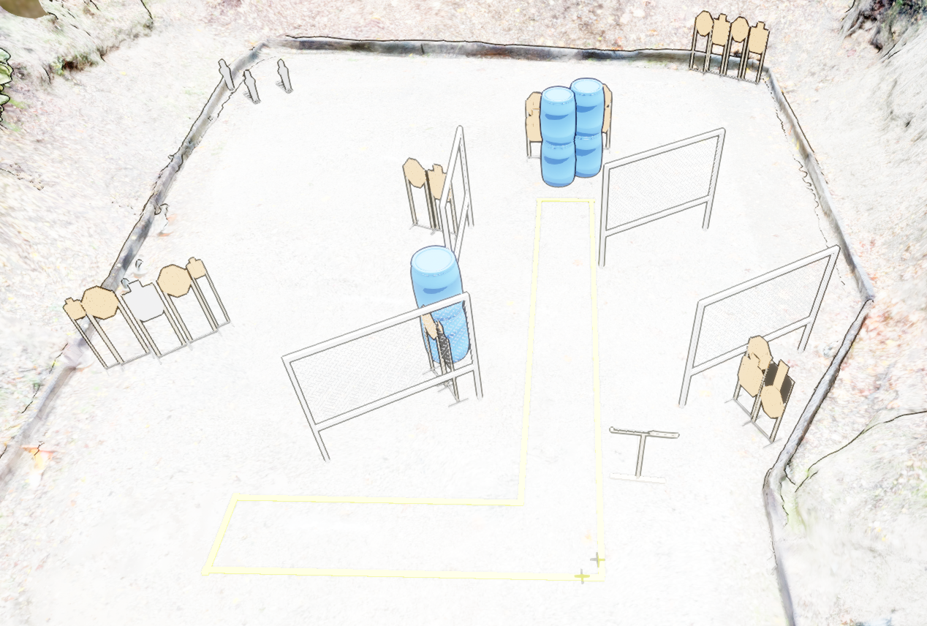
 | Stage 1 Check Your Corners Course Designer: Marcel Englmaier

